Slide 1
Welcome To Our Presentation

Slide 2
Group Members:
Saima Afrin (152-15-5905)
Tanjid Ibna Akid (152-15-5861)
Abu Sinha Md Sala Uddin (152-15-5581)

Slide 3
Presentation Topic:
Text Editor

Slide 4
What is a Text Editor ?
A text editor is a type of program used for editing plain text files. Such programs are sometimes known as "notepad" software, following the Microsoft notepad.
The first text editor – Line Editor
Style - Typewriter

Slide 5
Importing JAVA Package
There are many Java system packages:
lang
AWT
swing
io
util
Applet
net
We have used “awt”, “awt.event” and “swing” packages in our project code.

Slide 6
There are various kinds of Build in classes and methods that we use in here.
Classes Methods
MenuBar – File
-- Edit
-- View
TextArea
Scrollpane
MenuItem – Exit
-- Cut
--Copy
-- Paste
-- Select , Save, Load, Status
ToolBar

Slide 7
Diagram
Interface
actionListener
Jframe
TextEditor

Slide 8
Methods of Jframe class:
setSize : It Sets the size of this Dimension object to the specified width and height.
setLoctionRelativeTo: Basically it Sets the location of the window.
setDefaultCloseOperation(WindowConstants.EXIT_ON_CLOSE): It is used to close Frame as well as Java process.

Slide 9
setLayout: It allows us to set the layout of the container often a Jpanel. Our created class inherit the JFrame class and as we imported AWT and Swing package, so we have got the access of all classes and methods.

Slide 10
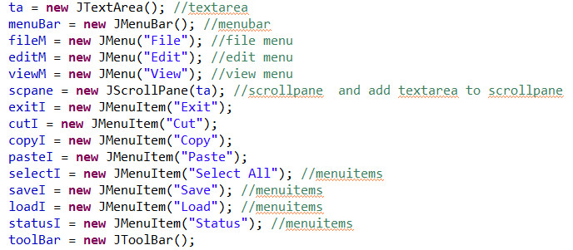
Creating objects for every Classes and Methods

Slide 11
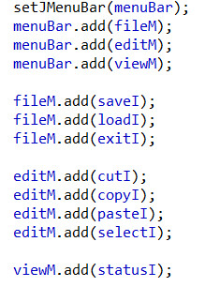
By “setJMenuBar” build in method we set up the menu bar

Slide 12
Using “ActionListener” Interface:
An ActionListener is an interface in pacakge “java.awt.event”. It has only one method “void actionPerformed(ActionEvent e)”. The class which processes the object of that class must be registered with a component. The object can be registered using the “addActionListener()” method. When the action event occurs, that object’s “actionPerformed” method is invoked.

Slide 13
We get one method under actionListener interface, named – “actionPerformed()”.
Using “actionPerfomed” method:
The performance of every method is defined here.
We use if-else condition for performing according to the users selection.

Slide 14
References:
https://en.wikipedia.org/wiki/Java_(programming_language)
http://www.codeproject.com/Tips/1061741/Simple-texteditor-with-Java-Swing
http://stackoverflow.com/questions/14115263/java-swing-text-editor
http://forum.codecall.net/topic/49721-simple-text-editor/
http://stackoverflow.com/questions/30947870/setlayout-function-main-purpose

Slide 15


Any Questions

Slide 16


